Slide 1
ONLINE SUBJECTIVE ANSWER CHECK
ABHISHEK VASANT GIRKAR VU4F1718022
MOHIT SUNIL KHAMBAYAT VU4F1718072
AJAY DATTATRY WAGHMARE VU2TS41718028

Slide 2
INTRODUCTION
Nowadays during this Covid-19 pandemic, everyone is working in a virtual manner. In the present scenario, manual evaluation of subjective answers is a hectic task. There are multiple systems which can evaluate objective type or MCQ questions quickly. These techniques are evaluated in machines itself after providing a pre-defined correct answers.
But it helps only in competitive or objective type exam evaluation. The subjective examinations are the backbone of all the universities and board level examinations.
Manual evaluation of subjective answers is a very tedious, time-consuming task and requires lots of manpower.
Answer evaluation varies from moderator to moderator according to their way of evaluation, mood at time of evaluation and interrelation between student and moderator.

Slide 3

EXISTING SYSTEM
All the papers are checked manually ,so checking paper manually that leads following points:
1) There maybe difference in checking paper by moderators.
2) It takes a lot of time to check large set of papers which is time consuming.
3) More efforts are required to check the paper manually.

Slide 4

LITERATURE SURVEY
Paper | Year & Publication | Techniques Used For Evaluation of Answer
Case Based Modeling of Answer Points to Expedite Semi-Automated Evaluation of Subjective Papers | IEEE, 2018 | Semantic Meaning and Length of Sentences
Subjective Answer Evaluation System | IJESC,2017 | Keyword Matching, Grammer check ,SpellCheck
AI Based E-Assessment System | EasyChair Preprint, March 2020 | TFIDF, Grammar check, WMD, cosine and Jaccard Similarity, spacy similarity, etc
An Adaptive Approach for Subjective Answer Evaluation | VIVA-Tech IJRI,2019 | Similarity based on Keyword matching, Sentence correctness, Synonyms etc
Answer Evaluation Using Machine Learning | McGraw-Hill March, 2018 | Keyword Matching , OCR technique

Slide 5

PROPOSED SYSTEM
In earlier system both answers need to be same word to word but in proposed systems answers need not to be same.
It will be able to check subjective answer written by student in an examination.
It will allocate marks accordingly as good as human being. It will help to reduce the wastage of resources like papers and much more things.
It will also overcome human limitations and speed up the overall paper evaluation.
Factors for evaluation are Answer length,Grammar Check, Keyword Matching, Contextual Similarity, Semantic Similarity, Cosine Similarity

Slide 6
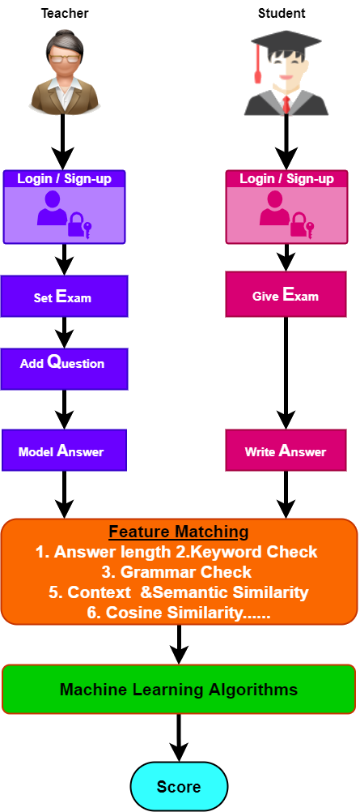
METHODOLOGY

Slide 7
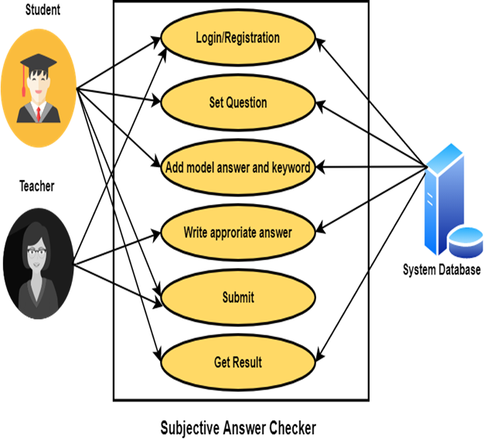
Use Case Diagram

Slide 8
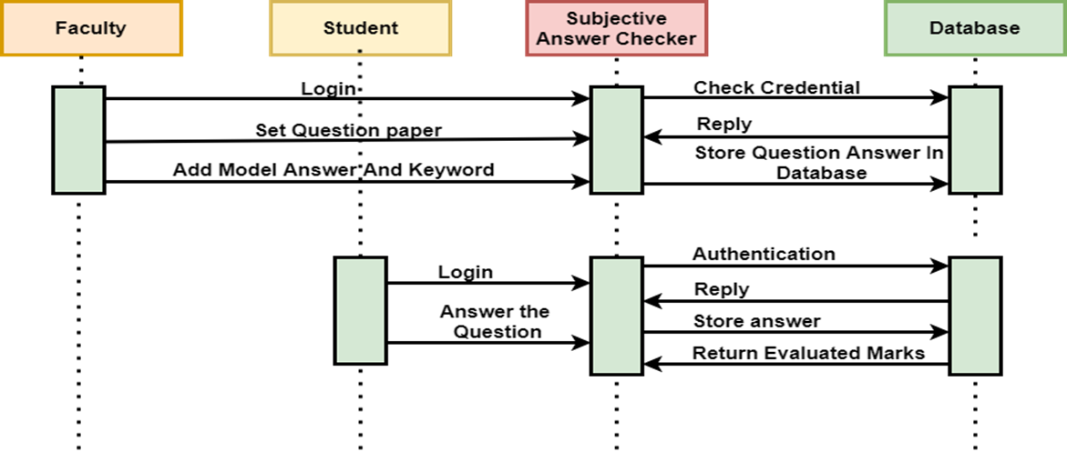
SEQUENCE DIAGRAM

Slide 9

Pre-Processing
1. Tokenization
2. WordNet
3. Removal of stopwords
4.Stemming and Lemmatization

Slide 10

Weighting Module for Evaluation of Answer
Answer length
Keyword Matching
Contextual Similarity
Semantic Similarity
Contradiction
Grammar Check
Cosine Similarity

Slide 11
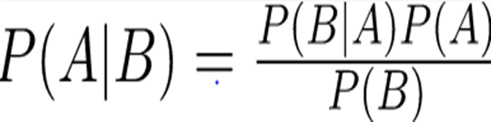
Naïve Bayes
Naïve Bayes algorithm is a supervised learning algorithm, which is based on Bayes theorem and used for solving classification problems.
It is mainly used in text classification that includes a high-dimensional training dataset.
Naïve Bayes Classifier is one of the simple and most effective Classification algorithms which helps in building the fast machine learning models that can make quick predictions.
It is a probabilistic classifier, which means it predicts on the basis of the probability of an object. The formula for Bayes theorem is given as

Slide 12
Linear Regression
Linear Regression attempt to model the relationship between two variables by fitting a linear equation to observed data.
The other is considered to be dependent variable. For Example: A modeler might want to relate weights of individuals to their heights using a linear regression model
Linear Regression attempt to model the relationship between two variables by fitting a linear equation to observed data.
The other is considered to be dependent variable. For Example: A modeler might want to relate weights of individuals to their heights using a linear regression model

Slide 13
CONCLUSION
We proposed Subjective Answer Checker System Using NLP and Machine Learning (Pariksha Software), would be helpful for online universities, schools and colleges level exam.
During this COVID-19 pandemic, most of educational institutes conduct their examinations online, but these exams only contain multiple choice questions.
Our Subjective Answer Evaluation software assign mark to subjective question based on Answer length, keyword matching, Grammar check, cosine similarity and Contextual similarity against Model answer provided by faculty and student answer.
We also developed algorithm to find contradicting statements from model answer with model answer.

Slide 14


